Slide 1
Notes of Deep Learning
[1]
Part I (chapter 2-5)
[1] Goodfellow, I., Bengio, Y., & Courville, A. (2016). Deep Learning. The MIT Press.

Slide 2
Part I: Applied Math and Machine Learning Basics
Chapter 2. Linear algebra
Chapter 3. Probability and information theory
Chapter 4. Numerical computation
Chapter 5. Machine learning basics

Slide 3
Part I: Applied Math and Machine Learning Basics
Chapter 4. Numerical computation

Slide 4
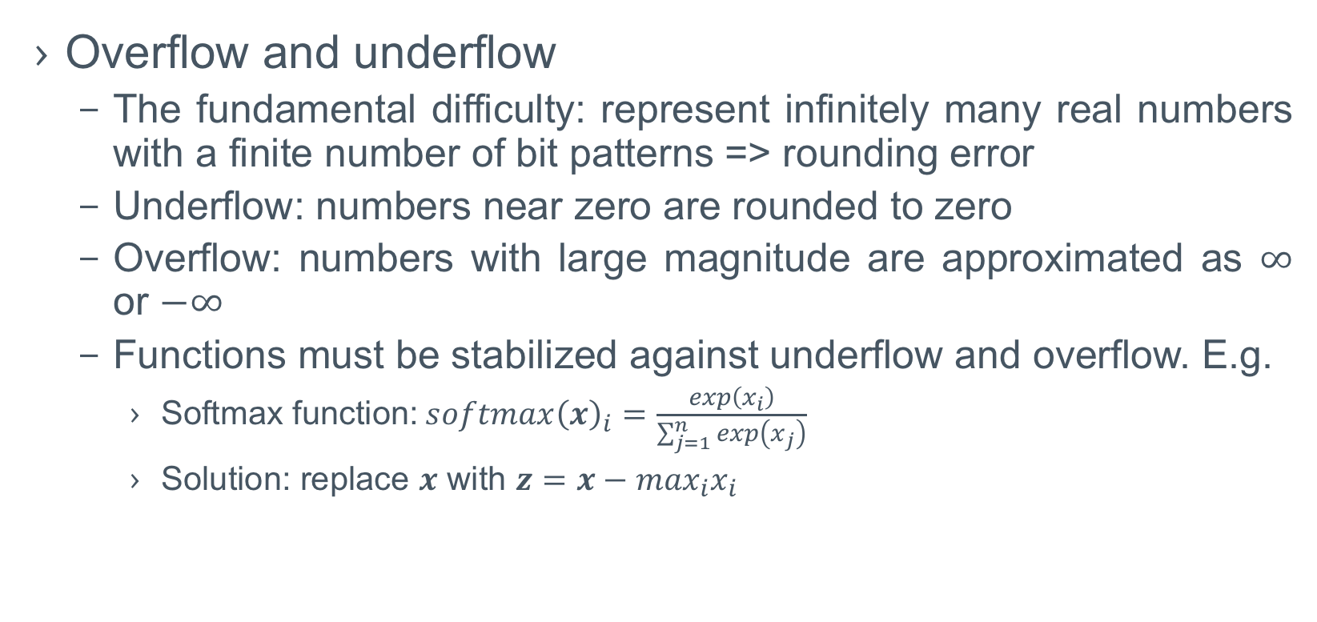
Numerical Computation
Overflow and underflow
The fundamental difficulty: represent infinitely many real numbers with a finite number of bit patterns => rounding error
Underflow: numbers near zero are rounded to zero
Overflow: numbers with large magnitude are approximated as $∞$ or $−∞$
Functions must be stabilized against underflow and overflow. E.g.
Softmax function: $softmax{\left(x\right)}_{i}=\frac{exp\left(x_{i}\right)}{\sum_{j=1}^{n}{exp\left(x_{j}\right)}}$
Solution: replace $x$ with $z=x−\max_{i}x_{i}$

Slide 5
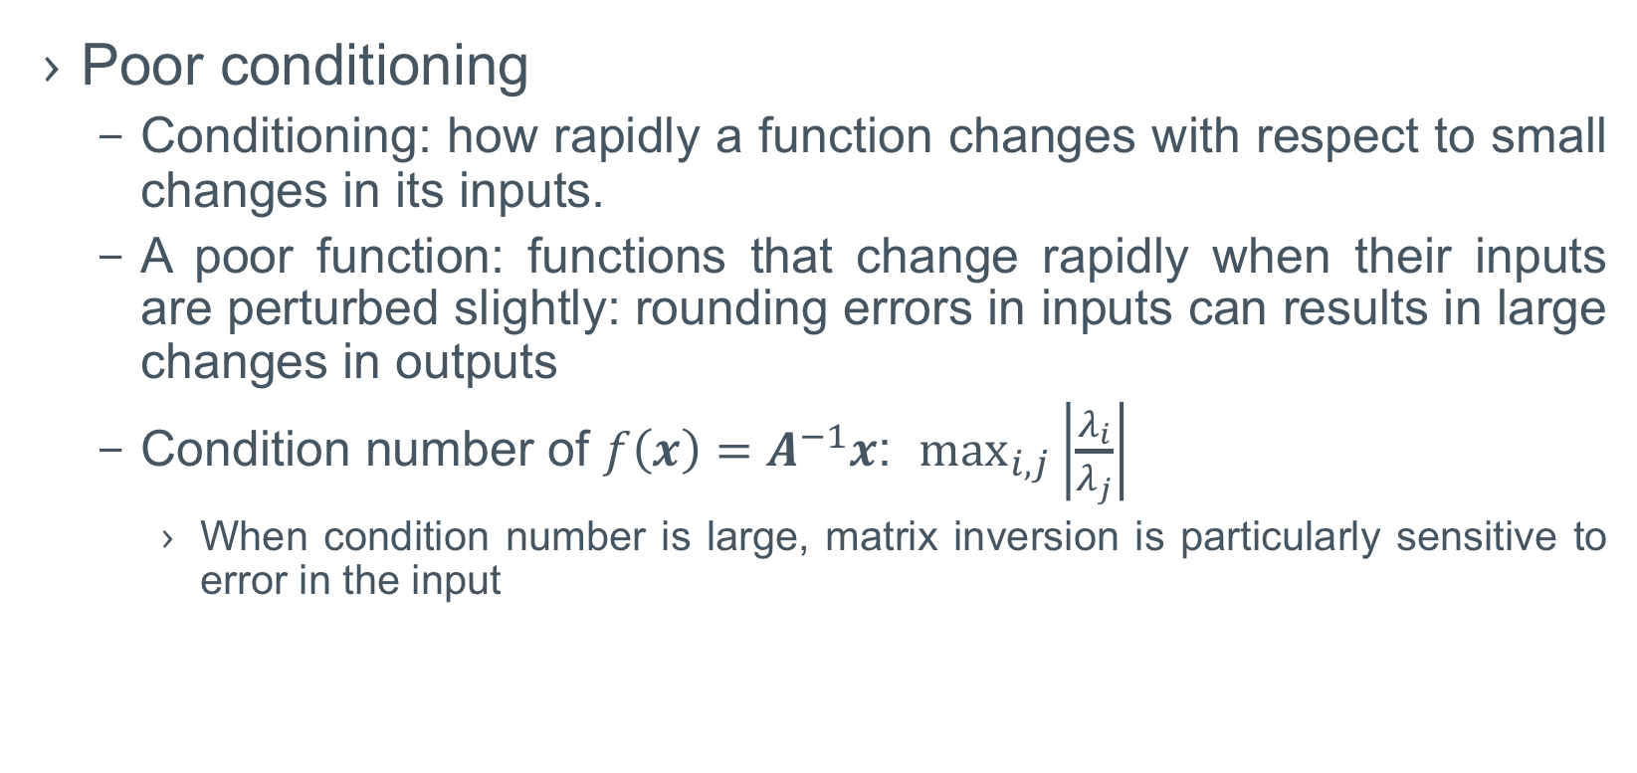

Numerical Computation
Poor conditioning
Conditioning: how rapidly a function changes with respect to small changes in its inputs.
A poor function: functions that change rapidly when their inputs are perturbed slightly: rounding errors in inputs can results in large changes in outputs
Condition number of $f\left(x\right)=A^{−1}x$: $\max_{i,j}\left|\frac{λ_{i}}{λ_{j}}\right|$
When condition number is large, matrix inversion is particularly sensitive to error in the input
$$cond\left(A\right)=\left\|A\right\|\left\|A^{−1}\right\|?$$

Slide 6
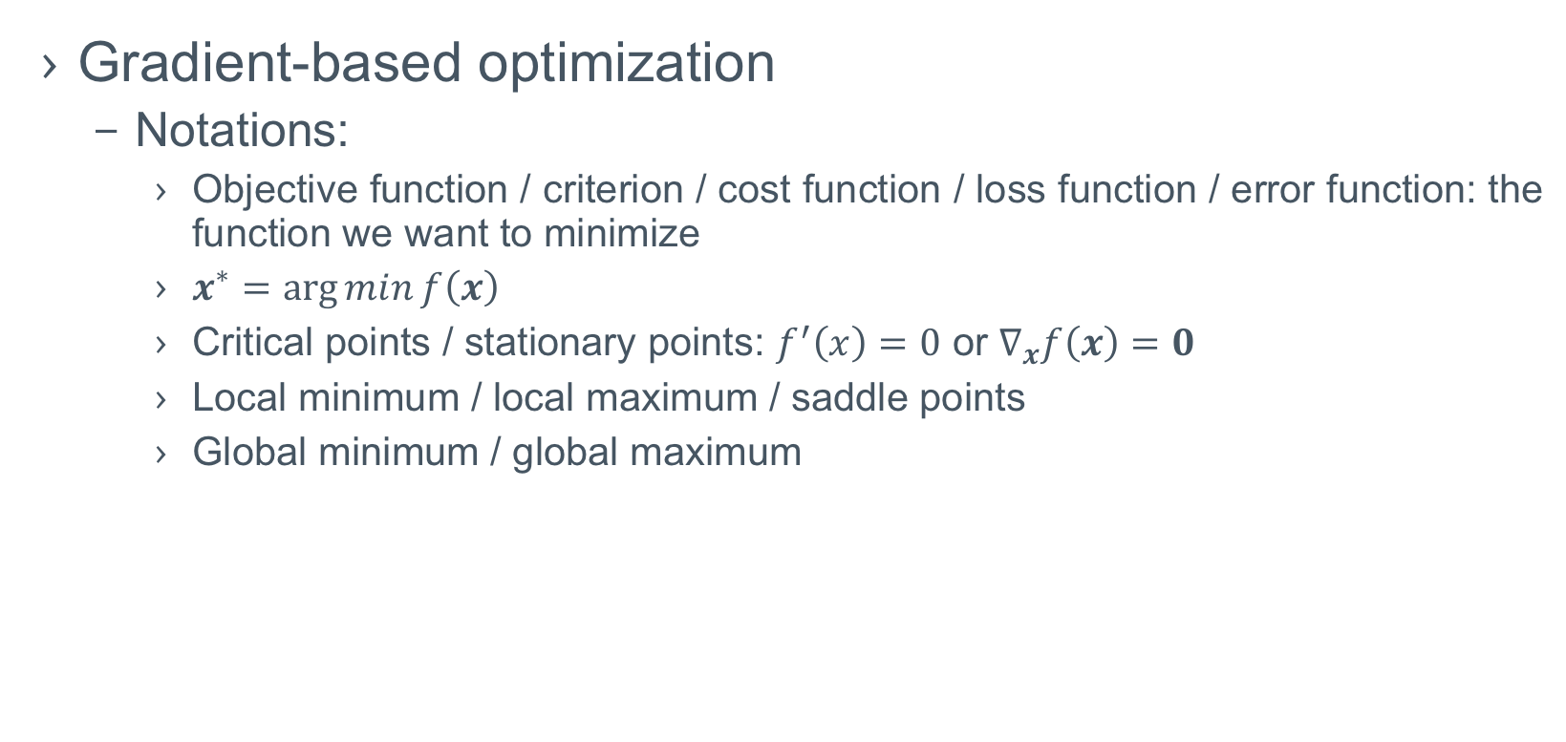
Numerical Computation
Gradient-based optimization
Notations:
Objective function / criterion / cost function / loss function / error function: the function we want to minimize
$x^{∗}=\arg{min}f\left(x\right)$
Critical points / stationary points: $f^{′}\left(x\right)=0$ or $∇_{x}f\left(x\right)=0$
Local minimum / local maximum / saddle points
Global minimum / global maximum

Slide 7
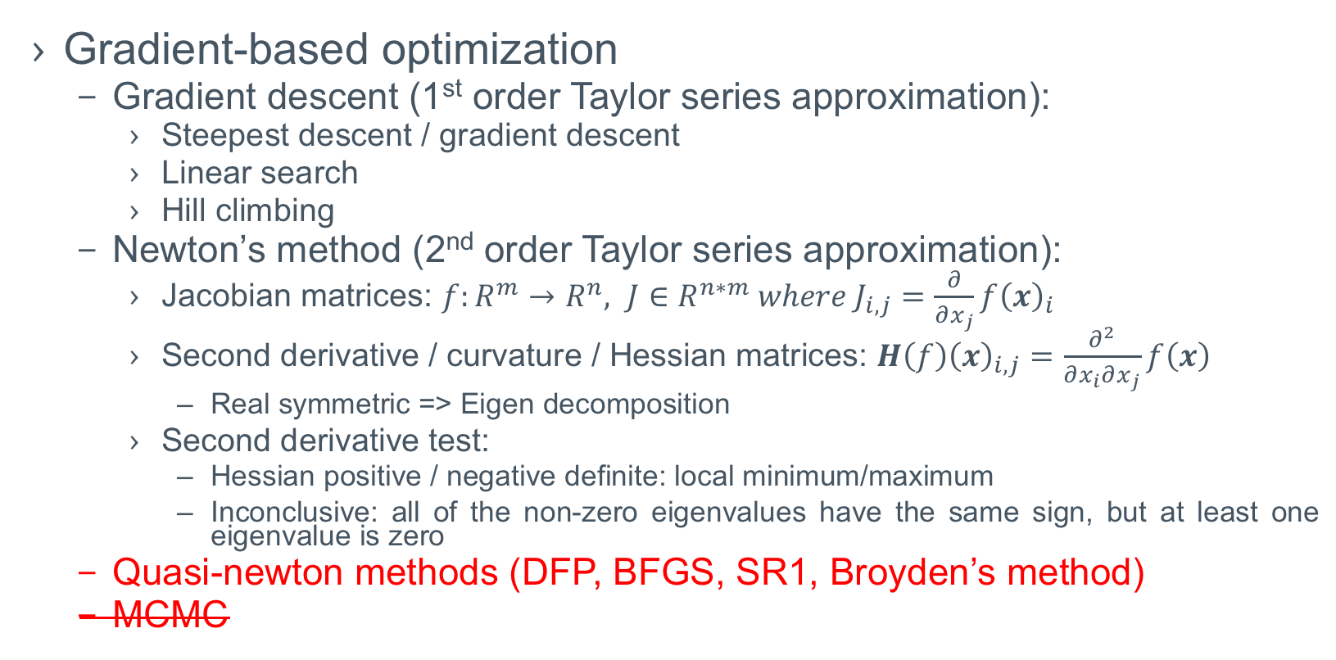
Numerical Computation
Gradient-based optimization
Gradient descent (1st order Taylor series approximation):
Steepest descent / gradient descent
Linear search
Hill climbing
Newton’s method (2nd order Taylor series approximation):
Jacobian matrices: $f:R^{m}→R^{n}, J∈R^{n∗m} where J_{i,j}=\frac{∂}{∂x_{j}}f{\left(x\right)}_{i}$
Second derivative / curvature / Hessian matrices: $H\left(f\right){\left(x\right)}_{i,j}=\frac{∂^{2}}{∂x_{i}∂x_{j}}f\left(x\right)$
Real symmetric => Eigen decomposition
Second derivative test:
Hessian positive / negative definite: local minimum/maximum
Inconclusive: all of the non-zero eigenvalues have the same sign, but at least one eigenvalue is zero
Quasi-newton methods (DFP, BFGS, SR1, Broyden’s method)
MCMC

Slide 8
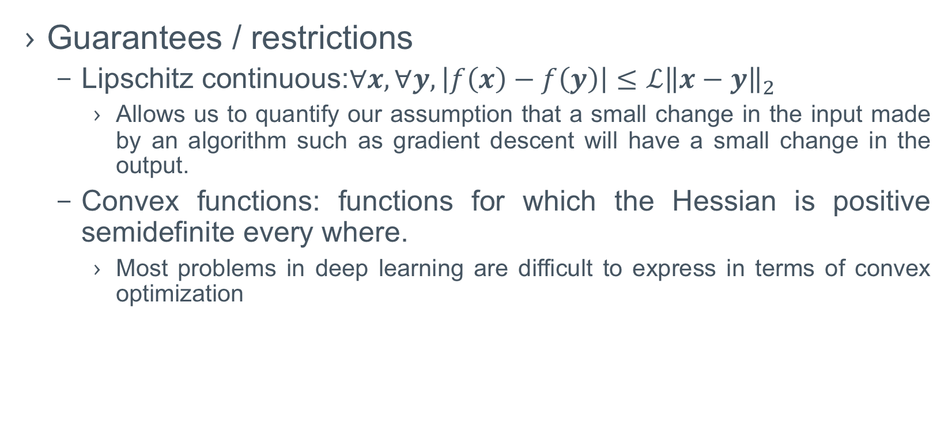
Numerical Computation
Guarantees / restrictions
Lipschitz continuous:$∀x, ∀y,\left|f\left(x\right)−f\left(y\right)\right|≤ℒ{\left\|x−y\right\|}_{2}$
Allows us to quantify our assumption that a small change in the input made by an algorithm such as gradient descent will have a small change in the output.
Convex functions: functions for which the Hessian is positive semidefinite every where.
Most problems in deep learning are difficult to express in terms of convex optimization

Slide 9
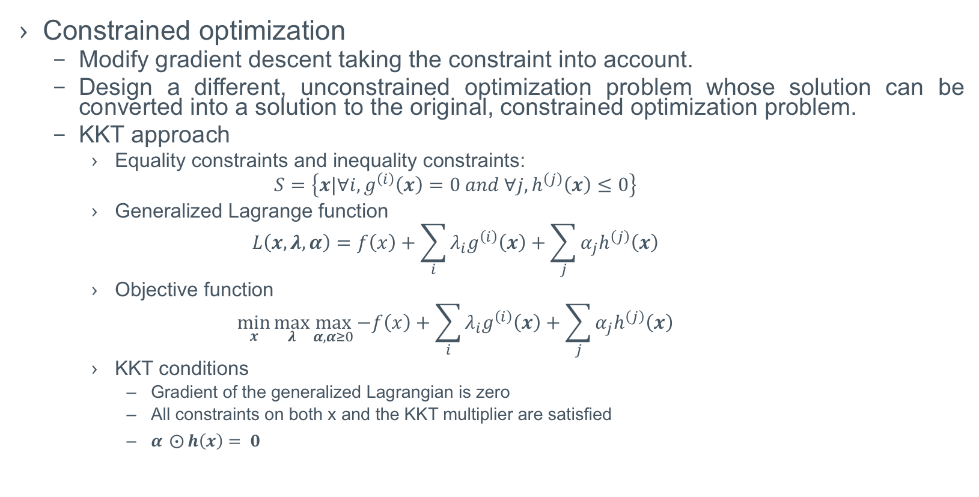
Numerical Computation
Constrained optimization
Modify gradient descent taking the constraint into account.
Design a different, unconstrained optimization problem whose solution can be converted into a solution to the original, constrained optimization problem.
KKT approach
Equality constraints and inequality constraints:
$$S=\left\{x|∀i,g^{\left(i\right)}\left(x\right)=0 and ∀j,h^{\left(j\right)}\left(x\right)≤0\right\}$$
Generalized Lagrange function
$$L\left(x,λ,α\right)=f\left(x\right)+\sum_{i}{λ_{i}g^{\left(i\right)}\left(x\right)}+\sum_{j}{α_{j}h^{\left(j\right)}\left(x\right)}$$
Objective function
$$\min_{x}{\max_{λ}{\max_{α,α≥0}{−f\left(x\right)+\sum_{i}{λ_{i}g^{\left(i\right)}\left(x\right)}+\sum_{j}{α_{j}h^{\left(j\right)}\left(x\right)}}}}$$
KKT conditions
Gradient of the generalized Lagrangian is zero
All constraints on both x and the KKT multiplier are satisfied
$α ⨀{h\left(x\right)}= 0$

Slide 10
To be continued…

